Slide 1

Bayes Inference
MsC in Data Science
University of Barcelona

Slide 2
Teachers
Nahuel Statuto Pérez
Enrique Mora

Slide 3
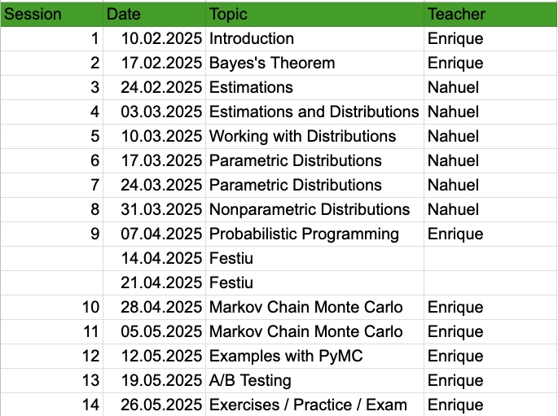
Course Syllabus

Slide 4
Course Evaluation
Class participation
Final Course Project (individual/groups)

Slide 5
Course Github
https://github.com/enriquemoraayala/BayesianInferenceUB25.git

Slide 6
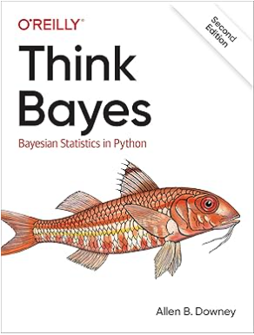
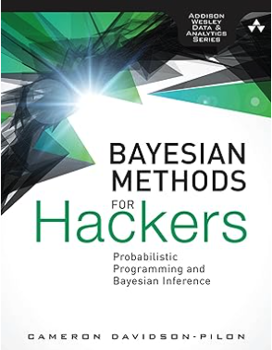
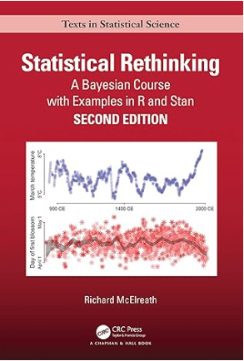
References

Slide 7
Exercise 1: Create a Bayesian Python Environment
You should know how:
python=3.10.
pytensor=2.26.3
pandas==2.0.3
seaborn==0.13.2
numpy=1.26.4
matplotlib==3.8.4
Jupyter

